Slide 1
Food Ordering Chatbot with FastAPI Backend
Improving Chatbot Responsiveness
Team Members:-
B Sasi Preetham - 20BCE7362
Gokavarapu Teja Naga Sai - 20BCE7361
Guided By:-
Dr. Ganesh Reddy Karri
SDP ID:20240116

Slide 2
Contents
AIM
OBJECTIVE
LITERATURE SURVEY
TOOLS AND TECHNOLOGIES
PROPOSED SYSTEM
WORK FLOW
FUTURE SCOPE
CONCLUSION
RESULTS

Slide 3




Aim
To develop a food ordering chatbot using Google Dialogflow and a backend Python FastAPI connected to a SQL database
By leveraging the strengths of both technologies, we anticipate achieving a seamless interaction between users and the chatbot while ensuring reliability, scalability, and ease of maintenance

Slide 4
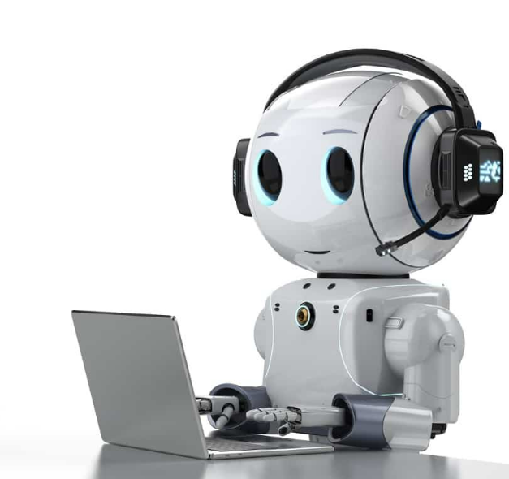
Objective
The primary objective is to enhance chatbot responsiveness through the implementation of FastAPI.
The secondary objective is to reduce misclassification errors.
The third objective is to reduce the learning curve to operate the chatbot.

Slide 5
Literature Survey
Research by Katharina Klein & Luis F. Martinez demonstrated that chatbots can significantly enhance the ordering experience for customers, leading to increased satisfaction and repeat business.
Similarly Pathan Mohd Shafi, Gauri S. Jawalkar, Manasi A. Kadam, Rachana R. Ambawale & Supriya V. Bankar found that implemention of chatbots increase sales providing great customer satisfaction.
In terms of technology, studies have focused on optimizing chatbot performance through various means, including the use of advanced NLP techniques, machine learning algorithms, and integration with third-party platforms. For instance, Ahmad Abdellatif; Khaled Badran; Diego Elias Costa; Emad Shihab proposed a comparative approach that reduce misclassification errors in chatbot interactions by Natural language platforms.

Slide 6


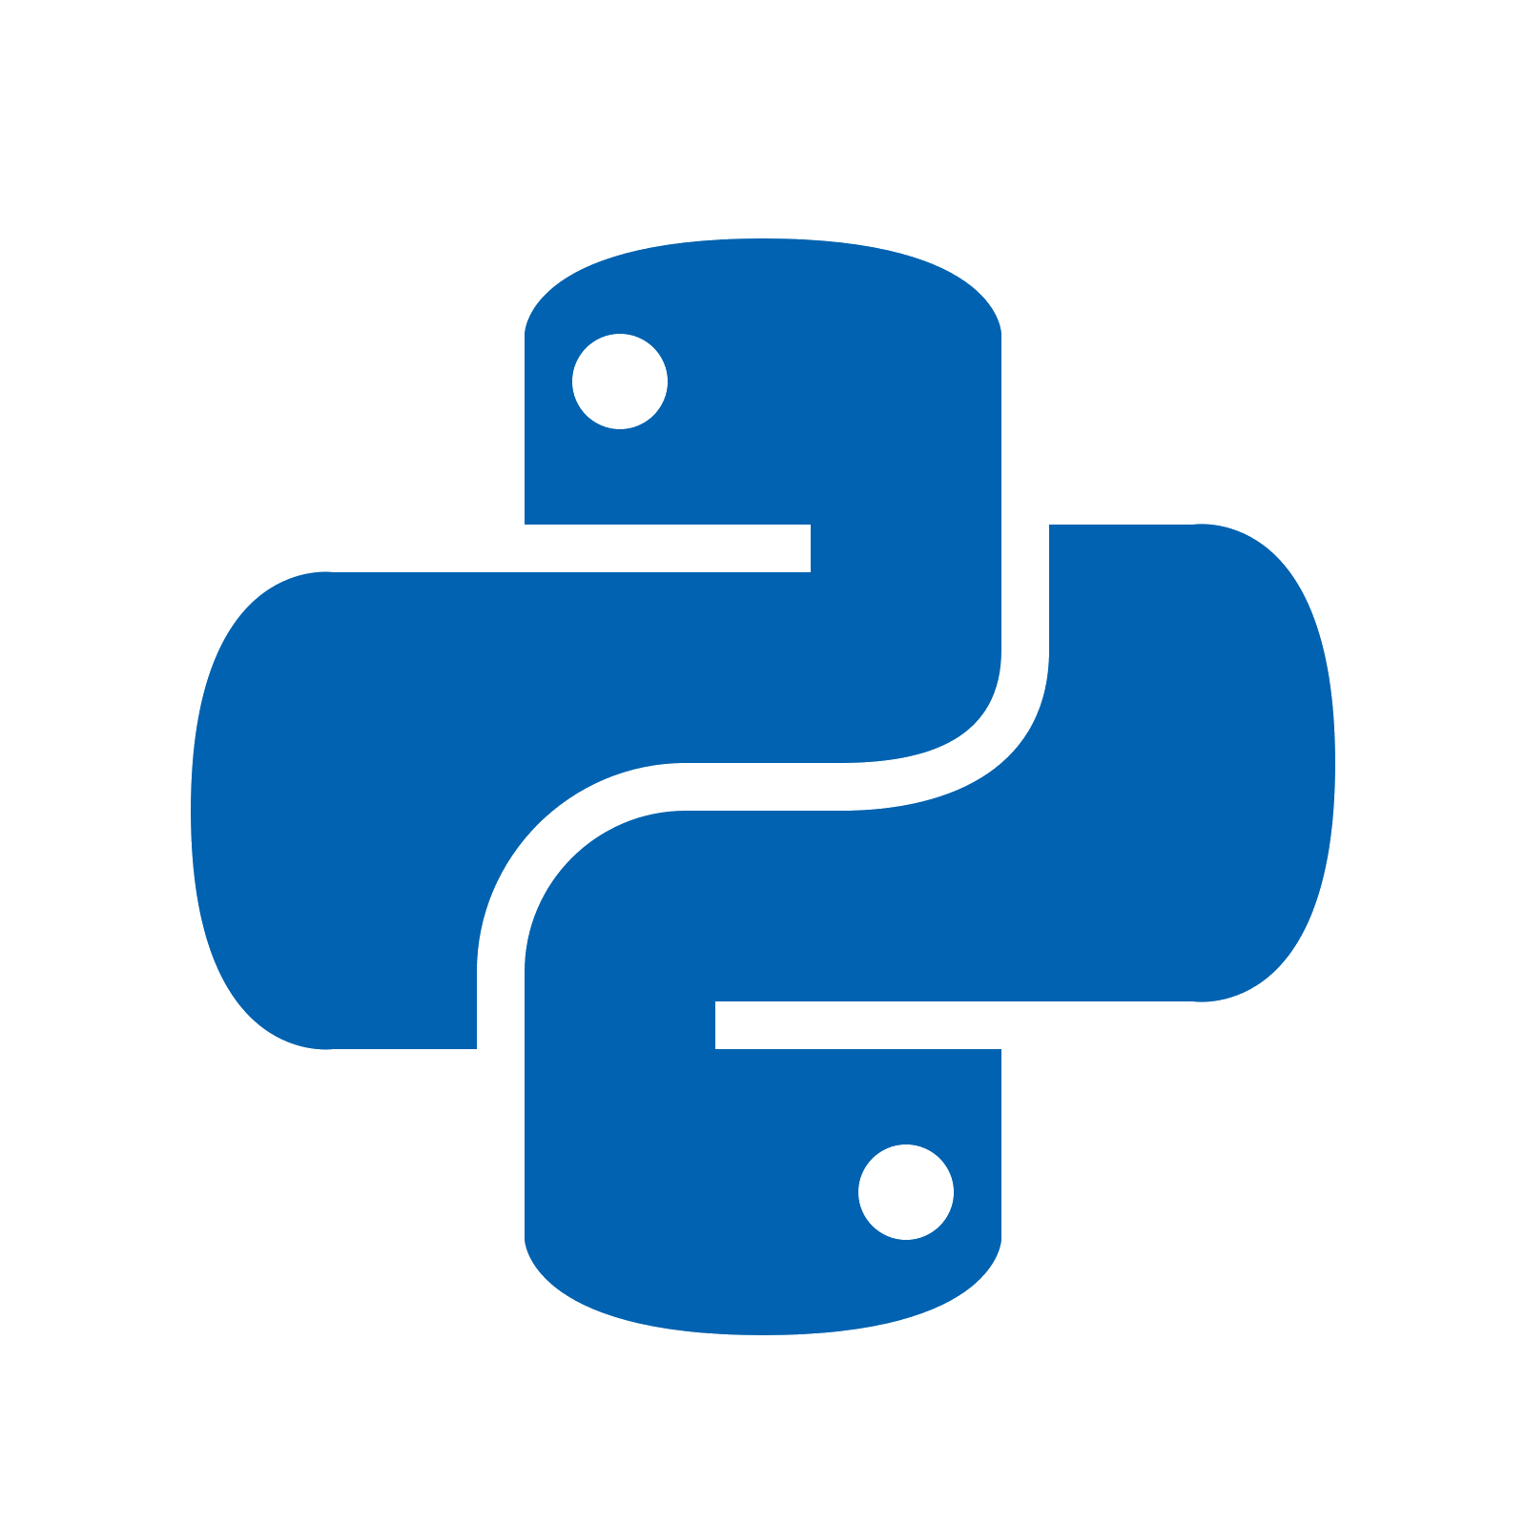
Tools and Technologies
MySQL Database: Use MySQL to store and manage order details, menu items, and customer information
Web Development: Basic web development skills (HTML, CSS, JavaScript) might be required to embed the chatbot on your website and handle frontend interactions.
Server-side Scripting: Python is used to create server-side scripts for integration with MySQL database and handling order-related operations.

Slide 7
Tools and Technologies
FastAPI:
FastAPI is known for its high performance
Asynchronous request handling
FastAPI is designed to be easy to use and intuitive
Dialogflow:
Dialogflow provides powerful NLP capabilities, allowing developers to build chatbots that can understand and interpret natural language input from users.
Dialogflow supports integration with multiple messaging platforms, including Google Assistant, Facebook Messenger, Slack, and more.
Dialogflow maintains context across conversational turns, allowing chatbots to remember previous interactions and provide more contextually relevant responses.

Slide 8
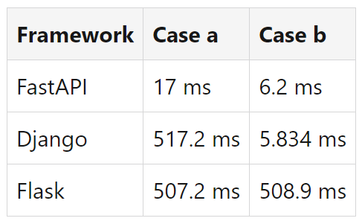
Why FastAPI?
FastAPI is about 7.5 times faster than Django and 11.35 times faster than Flask.
According to the benchmarks, the response time of FastAPI is around 10 milliseconds.
FastAPI can handle more than 21,000 requests per second, which is more than six times faster than Django.
FastAPI is the fastest Python web framework available, with a response time of 1.562 seconds. This is significantly faster than Django, which has a response time of 5.172 seconds, and Flask, which has a response time of 5.072 seconds.
Average time for the first call after server start up
Average time for consecutive calls after the first call

Slide 9
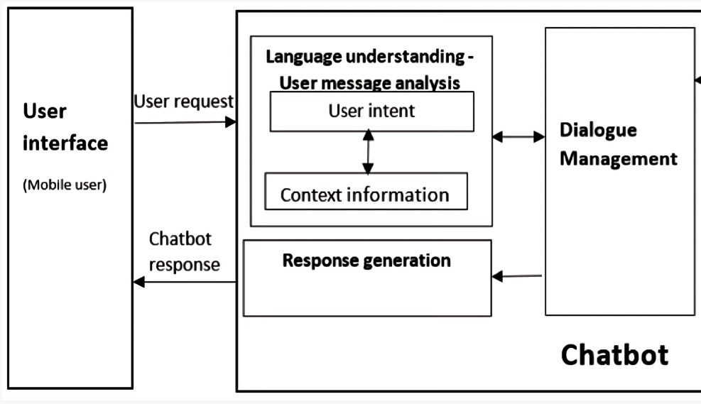










PROPOSED SYSTEM

Slide 10
Work Flow
Designing the conversation flow in Dialogflow
Developing the FastAPI backend for handling requests
Integrating Dialogflow with FastAPI
Setting up and managing the SQL database
Developing a website for food business
Integrating chatbot into website
Testing and iterating the chatbot functionality

Slide 11
Future Scope
Voice Ordering: Explore the implementation of voice recognition capabilities to enable users to place orders using voice commands, offering a hands-free and convenient ordering experience.
Integration with Payment Gateways: Extend the system's capabilities by integrating with secure payment gateways to facilitate seamless and secure transactions directly through the chatbot interface.
Multilingual Support: Enhance the chatbot's accessibility by adding support for multiple languages, catering to a diverse user base and expanding the reach of the system to international markets.

Slide 12
Conclusion
The combination of Google DialogFlow and FastAPI offers a powerful solution for developing responsive and efficient chatbots.
By leveraging DialogFlow's natural language understanding and FastAPI's high performance and ease of development, we aim to create a seamless food ordering experience.
Our project demonstrates the effectiveness of integrating cutting-edge technologies to enhance user interaction and streamline processes.
Moving forward, we anticipate further refinements and enhancements based on user feedback and ongoing development efforts.

Slide 13
THANK YOU

